Slide 1


Angularization
of
Personal Finance Manager.

Slide 2

What is Angular
Angular is a popular JavaScript framework
developed by google.
Notes:
Angular is a popular open-source web application framework primarily maintained by Google and a community of developers. It is used for building dynamic single-page web applications (SPAs) and large-scale enterprise applications. Angular utilizes TypeScript, a superset of JavaScript, for writing code, and follows the Model-View-Controller (MVC) architecture pattern to organize and manage the structure of web applications. It provides a comprehensive set of features, including data binding, dependency injection, modular development, and routing, making it a powerful framework for building modern web applications

Slide 3


Why Angular popular?
Component based architecture
Routing
Data Binding
Dependency Injection
Notes:
Angular is famous for several reasons:
Two-Way Data Binding: Angular's two-way data binding feature allows automatic synchronization of data between the model and the view, reducing the need for manual DOM manipulation.
Modularity: Angular promotes modularity through components and modules, enabling developers to build and maintain large-scale applications more effectively by breaking them down into smaller, reusable parts.
Dependency Injection: Angular's built-in dependency injection system helps manage dependencies between different components, making it easier to develop and test applications.
MVVM Architecture: Angular follows the Model-View-ViewModel (MVVM) architecture pattern, which promotes a clear separation of concerns and enhances code organization and maintainability.
TypeScript Integration: Angular is built with TypeScript, a statically typed superset of JavaScript. TypeScript provides features like type checking, which helps catch errors during development and improves code quality.
Active Community and Support: Angular has a large and active community of developers contributing to its ecosystem. This community support, along with comprehensive documentation and resources, makes it easier for developers to learn and adopt Angular.
Performance Optimization: Angular comes with built-in tools and features for performance optimization, such as Ahead-of-Time (AOT) compilation, lazy loading, and tree-shaking, which help improve the loading speed and overall performance of applications.
Cross-Platform Development: Angular supports cross-platform development, allowing developers to build web, mobile, and desktop applications using the same framework and codebase, thanks to frameworks like Angular Universal for server-side rendering and NativeScript for mobile app development.
These factors contribute to Angular's popularity and widespread adoption in the web development community.

Slide 4

Single Page Application (SPA)
Dynamically updates a single HTML page
than reloading entire
pages or navigating to different pages
.
Faster UI, more interactive.
All components reside within the same browser session
Business logic remains consistent throughout the page.
Notes:
A Single Page Application (SPA) is a web application or website that dynamically rewrites the current page rather than loading entire new pages from the server. In a traditional multi-page application (MPA), each link or action typically results in a full page reload. In contrast, SPAs use AJAX (Asynchronous JavaScript and XML) and client-side rendering to update the content of the page dynamically without requiring a full page reload.
Key characteristics of SPAs include:
Dynamic Content Loading: SPAs load data from the server asynchronously, typically in the background, and update the content of the page dynamically without requiring a full page refresh.
Smooth User Experience: Since SPAs only update portions of the page that have changed, they provide a smoother and more responsive user experience compared to traditional multi-page applications.
Client-Side Rendering: SPAs render the user interface on the client side (in the browser) using JavaScript frameworks like Angular, React, or Vue.js, instead of relying on server-side rendering.
Routing: SPAs often use client-side routing to manage navigation within the application. This allows users to navigate between different views or "pages" without triggering full page reloads.
State Management: SPAs typically manage application state on the client side, either using local state management solutions or external state management libraries like Redux or Vuex.
SEO Challenges: Since SPAs initially load a minimal HTML shell and render content dynamically, they can present challenges for search engine optimization (SEO). However, techniques like server-side rendering or pre-rendering can be used to address these challenges.
Popular examples of SPAs include Gmail, Google Maps, Facebook, and Twitter. SPAs have become increasingly popular for building modern web applications due to their improved performance, interactivity, and user experience.

Slide 5

Angular CLI(Command Line Interface)
Command-line tool that makes it easy to create, develop, and maintain Angular applications.
Provides a set of useful commands and tools to create test and deploy angular applications quickly.
Built on top of Node.js and uses the npm package manager to manage dependencies.
Notes:
Project Generation: Angular CLI allows developers to quickly scaffold a new Angular project by running a simple command (ng new). It sets up a basic project structure with recommended configurations and dependencies.
Code Generation: Angular CLI provides commands for generating components, services, modules, directives, pipes, and more, using the ng generate (or ng g) command. This helps maintain consistency in naming conventions and project structure.
Development Server: Angular CLI includes a built-in development server that can be launched with the ng serve command. This server supports live reloading, allowing developers to see changes in their application immediately as they make edits.
Testing: Angular CLI integrates with testing frameworks like Karma and Jasmine, making it easy to create and run unit tests and end-to-end tests for Angular applications using commands such as ng test and ng e2e.
Build Optimization: Angular CLI offers commands (ng build) for building production-ready bundles of the application. It optimizes the build output by bundling, minifying, and tree-shaking the code to improve performance and reduce file sizes.
Configuration Management: Angular CLI provides configuration files (angular.json or angular-cli.json in older versions) for managing various aspects of the project, including build options, assets, environment variables, and more.
Integration with Angular Schematics: Angular CLI leverages Angular Schematics to enable third-party libraries and tools to extend its capabilities and provide custom project templates, schematics, and code generators.
Overall, Angular CLI simplifies the development workflow for Angular projects, enhances productivity, and ensures best practices are followed throughout the development process.

Slide 6

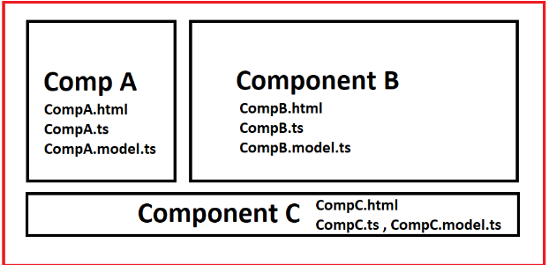
COMPONENTS
Components are the most basic UI building block of an Angular app. An Angular app contains a tree of Angular components.
Notes:
Here are the key features and concepts related to Angular components:
Component Structure: Each Angular component typically consists of three main parts:
Template: Contains the HTML markup that defines the structure of the component's view.
Class: Contains the TypeScript code that defines the component's behavior, properties, and methods.
Styles: Optionally, contains CSS styles specific to the component.
Component Decorator: Components in Angular are decorated with the @Component decorator, which provides metadata about the component, such as its selector, template, styles, and more.
Component Lifecycle Hooks: Angular provides a set of lifecycle hooks that allow developers to tap into various stages of a component's lifecycle, such as initialization, content projection, change detection, and destruction. Examples of lifecycle hooks include ngOnInit, ngOnChanges, ngAfterViewInit, and ngOnDestroy.
Data Binding: Components in Angular support various types of data binding, including:
Interpolation: Binding data from the component class to the template using double curly braces ({{ }}).
Property Binding: Binding HTML element properties to component properties using square brackets ([]).
Event Binding: Binding HTML element events to component methods using parentheses (()).
Two-Way Binding: Binding data and events using the [(ngModel)] syntax (requires FormsModule or ReactiveFormsModule for forms).
Input and Output Properties: Components can communicate with their parent and child components using input and output properties. Input properties (@Input) allow data to be passed from parent to child components, while output properties (@Output) allow child components to emit events to communicate with their parent components.
Component Composition: Angular encourages component-based architecture, where larger UIs are built by composing smaller, reusable components. This approach promotes code reusability, maintainability, and scalability.
Overall, components play a central role in structuring Angular applications, facilitating modular development, code organization, and separation of concerns.

Slide 7
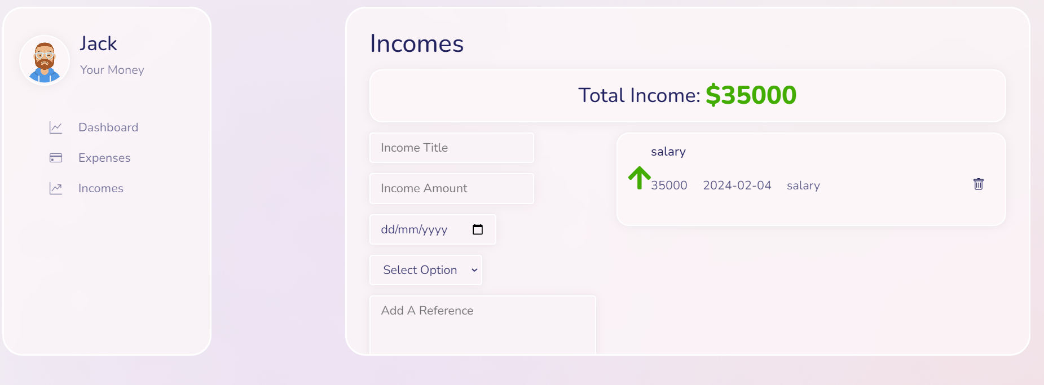
component1
component2

Slide 8

Module
A container for a set of related components, directives, pipes, and services, and it helps to organize and encapsulate different parts of an application.
Notes:
Here are the key concepts related to modules in Angular:
NgModule Decorator: Modules in Angular are created using the @NgModule decorator. This decorator is used to annotate a class and provide metadata about the module, such as its imports, declarations, providers, and exports.
Imports: The imports property of the @NgModule decorator is used to import other modules that are required by the current module. These can include built-in Angular modules like CommonModule or FormsModule, as well as custom feature modules.
Declarations: The declarations property of the @NgModule decorator is used to declare the components, directives, and pipes that belong to the current module. These components, directives, and pipes are only available to other components within the same module.
Providers: The providers property of the @NgModule decorator is used to register services within the module. These services are available for injection throughout the module and its components.
Exports: The exports property of the @NgModule decorator is used to export components, directives, and pipes from the current module, making them available for use in other modules that import the current module.
Bootstrap Component: In the root module of an Angular application, there is typically a bootstrap property in the @NgModule decorator that specifies the root component of the application. Angular starts the application by bootstrapping this component.
Feature Modules: Apart from the root module, Angular applications can have additional feature modules. These modules encapsulate specific features or functionality of the application. Feature modules help in organizing the application into smaller, more manageable pieces and facilitate code reusability.
Overall, modules in Angular provide a way to organize and structure Angular applications, promote modularity, and facilitate code organization and maintainability. They are essential for building scalable and maintainable Angular applications.

Slide 9
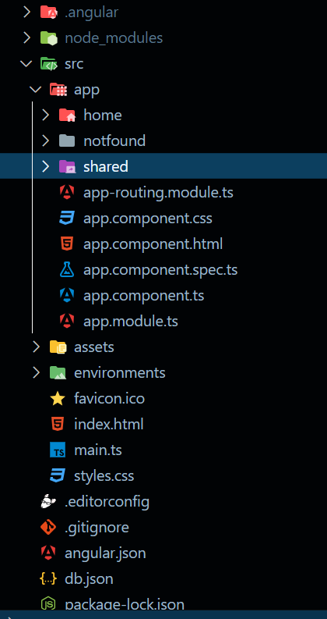
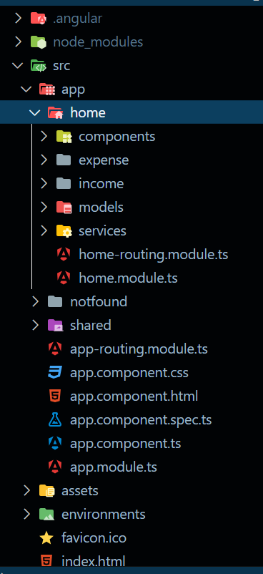
Project structure
Modules

Slide 10
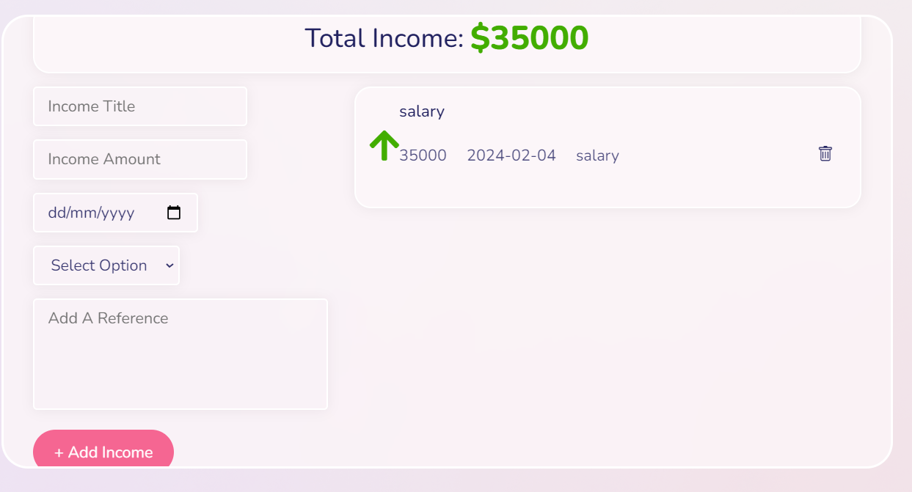
Data Binding
Data binding
Two-way process
Can both send and receive data between component’s TypeScript code and its template (HTML).

Slide 11
Routing
Process of navigating between different components and views within an Angular application
Sidebar Component
Navbar Component
dashboard
App Component
Income Component
Expense
Component
Notes:
Here are the key concepts related to routing in Angular:
RouterModule: Angular's routing functionality is provided by the RouterModule, which is part of the @angular/router package. Developers need to import RouterModule and configure routes in the application's root module (usually AppModule) to enable routing.
Routes Configuration: Routes are defined using an array of route objects in the application's routing module. Each route object specifies a path and the component to display when that path is matched. Additionally, routes can have additional properties such as route parameters, data, and guards.
RouterOutlet: To display the components associated with different routes, Angular provides the <router-outlet> directive. This directive acts as a placeholder in the application's HTML where the matched component's view will be rendered based on the current route.
RouterLink: Angular provides the routerLink directive for creating navigation links within the application's templates. The routerLink directive allows developers to navigate to different routes by clicking on links without triggering a full page reload.
Route Parameters: Routes in Angular can contain parameters, which allow for dynamic navigation based on user input or other factors. Route parameters are defined using the :paramName syntax in the route path and can be accessed in the component using the ActivatedRoute service.
Route Guards: Angular provides route guards to protect routes and control navigation based on certain conditions. Route guards can be used to implement authentication, authorization, and other navigation-related logic. Angular provides several types of route guards, including CanActivate, CanActivateChild, CanDeactivate, and Resolve.
Lazy Loading: Angular supports lazy loading, which allows developers to load feature modules and their associated routes asynchronously. This helps improve application startup performance by only loading the necessary code when navigating to specific routes.
Overall, routing in Angular provides a powerful mechanism for navigating between different views and components within an application, enabling developers to create rich, interactive, and dynamic single-page applications (SPAs).

Slide 12

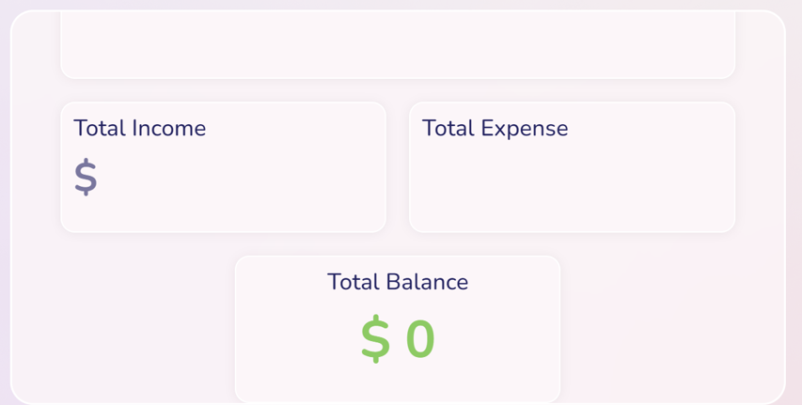
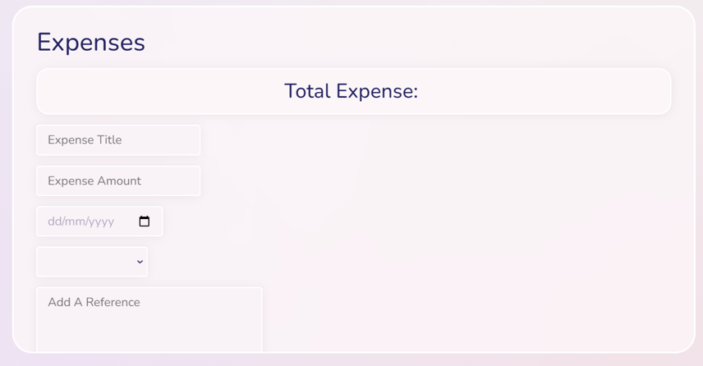
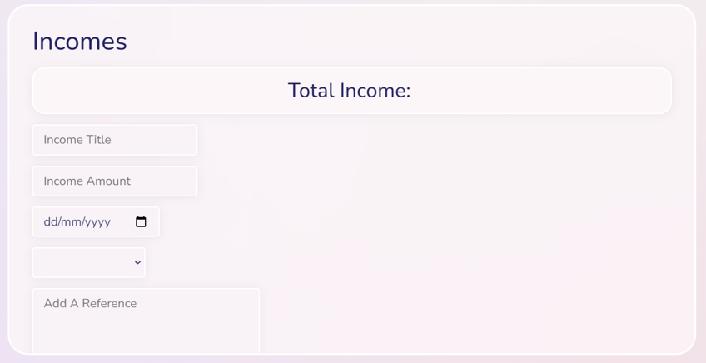
Routing Illustration

Slide 13

Angular Forms
Angular forms are a key feature that allows users to interact with web applications by inputting data.
They handle user input, provide validation to ensure data accuracy, and offer error messages for incorrect entries.
Forms maintain their state, making it easy to track user actions, and can be created using either template-driven or reactive approaches for flexibility and ease of use.
Notes:
In Angular, forms are an essential part of building interactive web applications. Angular provides two approaches for working with forms: Template-driven forms and Reactive forms.
Template-driven Forms:
Template-driven forms are built using template-driven syntax in Angular templates.
They are suitable for simple forms with basic validation requirements.
Form controls are created and managed directly within the HTML template using directives such as ngModel, ngForm, ngSubmit, etc.
Validation is achieved using Angular's built-in validators or custom validators.
Template-driven forms automatically track the state and validity of form controls and can display validation errors based on their state.
Template-driven forms are relatively easier to set up and are ideal for quick prototyping or simple forms where complex validation logic is not required.
Reactive Forms:
Reactive forms are built using reactive programming principles and are managed programmatically in TypeScript.
They are suitable for complex forms with dynamic form controls, conditional validation, and complex validation requirements.
Form controls are created and managed programmatically using Angular's FormControl, FormGroup, and FormArray classes.
Reactive forms provide a more flexible and powerful approach to form handling, allowing for dynamic modification of form controls and validation logic.
Validation is achieved by defining validators directly in the TypeScript code.
Reactive forms provide better control over form state and allow for more advanced features such as form initialization, form grouping, dynamic form controls, and custom form control components.
Reactive forms are recommended for building large-scale applications with complex forms and advanced validation requirements.
Both template-driven forms and reactive forms have their advantages and use cases. The choice between them depends on the specific requirements of the application and the complexity of the form being built.

Slide 14

Introduction To Reactive forms
Reactive forms in Angular provide a programmatic and flexible approach to form creation and management.
Unlike template-driven forms, they are defined in TypeScript classes, allowing fine-grained control over form elements and validation rules.
Reactive forms use observables from RxJS to handle form state changes and asynchronous operations efficiently, making them ideal for complex forms with dynamic behaviour and advanced validation needs.
Notes:
Key components and concepts of reactive forms in Angular include:
FormControl: Represents a single form control, such as an input field. It encapsulates the current value, validation status, and other properties of the control.
FormGroup: Represents a group of form controls. It organizes related form controls into a single object and tracks the overall validity and value of the group.
FormArray: Represents an array of form controls. It allows for dynamic creation and management of form controls within an array.
FormBuilder: A service provided by Angular for simplifying the creation of form controls and groups. It provides convenient methods for creating instances of FormControl, FormGroup, and FormArray.
Validators: Functions used for defining validation rules for form controls. Angular provides built-in validators such as required, minLength, maxLength, pattern, etc., as well as the ability to create custom validators.
To create a reactive form in Angular, you typically follow these steps:
Import the necessary modules from @angular/forms, including ReactiveFormsModule in your application module.
Define form controls, groups, and arrays in the component class using instances of FormControl, FormGroup, and FormArray.
Set up validation rules using validators provided by Angular or custom validators.
Bind the form controls to elements in the template using the formControlName directive or by binding to the FormControl instance directly.
Handle form submission and interaction logic in the component class using methods provided by the FormGroup or FormControl instances.
Reactive forms offer greater flexibility, control, and scalability compared to template-driven forms, making them suitable for building complex forms and large-scale applications. They are particularly useful when dynamic form controls, conditional validation, or complex form logic is required.

Slide 15
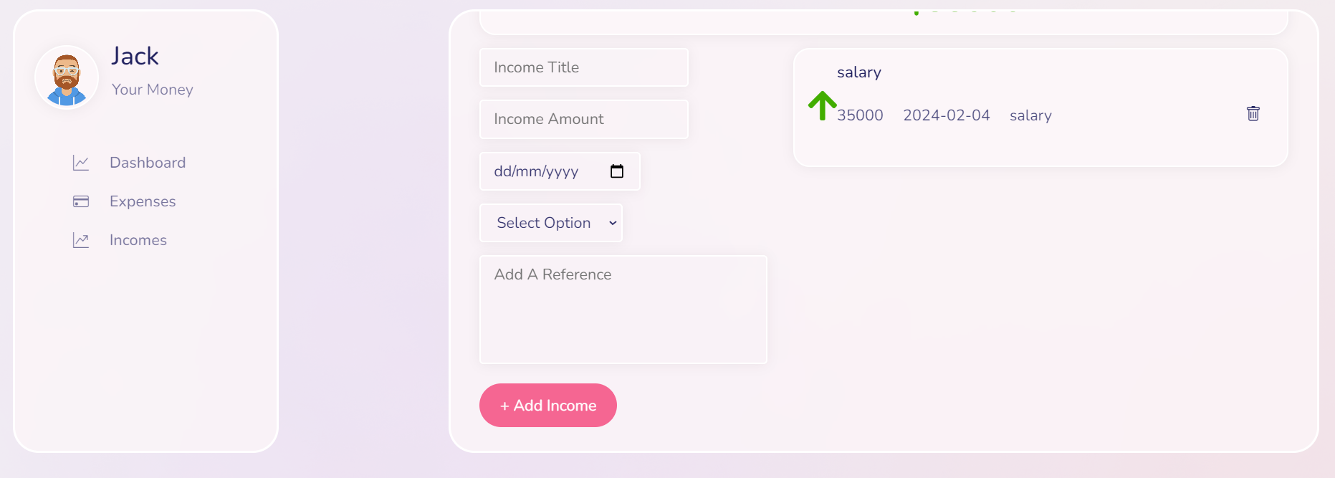
Reactive Form
Reactive form
Notes:
In Angular, services are a fundamental part of the architecture used for organizing and sharing code across different parts of an application. They are a way to encapsulate functionality that doesn't belong in a specific component, such as data access, logging, authentication, and other reusable behaviors.
Here are the key aspects of services in Angular:
Singleton Instances: When you inject a service into a component or another service, Angular creates a single instance of that service and shares it throughout the application. This ensures that the state and behavior of the service remain consistent across different parts of the application.
Dependency Injection: Angular's dependency injection system is used to provide instances of services to components, directives, and other services that require them. This allows for loose coupling between different parts of the application and facilitates unit testing.
Encapsulation of Reusable Logic: Services encapsulate reusable logic and functionality that can be shared across multiple components. This promotes code reuse, maintainability, and scalability by avoiding duplication of code and promoting separation of concerns.
Separation of Concerns: By moving business logic, data access, and other shared functionality into services, Angular applications follow the principle of separation of concerns. This makes it easier to maintain, test, and extend the application over time.
HttpClient and API Communication: Services are commonly used to encapsulate HTTP requests and handle communication with backend APIs using Angular's HttpClient module. This allows for a clean separation between data access logic and presentation logic in components.
Lifecycle Hooks and Observables: Services can utilize Angular's lifecycle hooks (OnInit, OnDestroy, etc.) and observables to perform initialization tasks, manage resources, and handle asynchronous operations.
Providers: Services are typically registered with Angular's dependency injection system using the @Injectable() decorator. Providers can be configured at the module level (using the providers array in the module metadata) or at the component level (using the providers property in the component metadata).
Overall, services play a crucial role in Angular applications by facilitating code organization, reuse, and maintainability, as well as promoting best practices such as separation of concerns and dependency injection.

Slide 16
Services in Angular
Service is the act of providing assistance or fulfilling a need for someone or something.
It involves delivering a specific task, support, or solution to meet the requirements of others.
Services are intangible and can encompass a wide range of activities, from customer support to professional expertise.
The goal of service is to enhance the well-being or satisfaction of individuals or organizations.

Slide 17
RECAP
Single page Application
Angular CLI
Components in Angular
Module in Angular
Data binding in Angular
Routing in Angular
Reactive form in Angular
Services in Angular

Slide 18
Thanks!!

